Slide 1
Administrate SharePoint Online Customizations
Speaker Name

Slide 3
Objectives
After completing this lesson, you will be able to:
Explain which customization options are available and how to administer those customizations.
Administer theming for your SharePoint Online Tenant.
Understand what are site designs and how to configure site designs for a Tenant.
Notes:
Objectives
After completing this lesson, you will be able to:
Explain what customization options are available for SharePoint Online.
Understand the concepts of site design and site scripts from and Administrator Perspective.
Administrate Theming for your SharePoint Online Tenant

Slide 4
SharePoint Online Customizations - An overview for Administrators

Slide 5
Introduction
Branding and customizing SharePoint Online is different than branding and customizing SharePoint Server products.
SharePoint Online gets updated with new features on a regular basis and these updates can affect certain types of customizations.
There are recommended customization and branding techniques available today that can streamline your branding and customization requirements.
Notes:
Branding and customizing SharePoint Online is different than branding and customizing SharePoint Server products.
SharePoint Online gets updated with new features on a regular basis and these updates can affect certain types of customizations. However, there are recommended customization and branding techniques available today that can streamline your branding and customization requirements.
Although, SharePoint Online Customization is a developer-oriented topics but there are times when you as an Administrator has to enable/disable some of the options for customizing you SharePoint Online Tenant. Let's Explore them!

Slide 6
Customizations – simple to complex
Although SharePoint Online Customization is a developer-oriented topic however there are times when you as an Administrator must enable/disable some of the options for customizing your SharePoint Online Tenant.
Let’s explore them!
Customizations using the browser
Examples include Site Pages, logo, site theme, Page Comments, or navigation links.
Customizations using supported tools and applications
For example, PowerApps and Power Automate can be used to add custom forms and flows to your site.
Customizations using add-ins for SharePoint
The new Cloud App Model in SharePoint Online enables you to add apps to your sites.
Third-party apps
Third-party apps are found in the SharePoint Store, which is a Microsoft marketplace accessible from SharePoint Online sites.
Notes:
Customizations: simple to complex
SharePoint Online customizations range from non-technical changes you can apply quickly in the browser using site commands or features to custom app development using developer tools:
Customizations using the browser You can use the browser-based settings SharePoint Online to apply simpler customizations like changing title and logo, updating navigation links, applying a new site theme, changing the contents of a page, or changing views for lists and libraries. Browser-based customizations are the easiest customizations to apply, and they require minimal technical expertise.
Customizations using supported tools and applications You can use supported SharePoint tools to perform more extensive customizations. For example, Office applications like Excel, and Visio help you create highly dynamic, data-rich pages on your site. Or PowerApps and Power Automate – being the preferred option.
Customizations using add-ins for SharePoint The new Cloud App Model in SharePoint Online enables you to add apps to your sites and is the recommended replacement for Sandboxed solutions going forward. You can use existing third-party apps or build your own. Add apps to a site when you want to customize it with specific functionality or information. For example, you can add apps that perform general tasks like time and expense tracking. Or you can use apps and remote provisioning to apply branding elements to sites. You can also add apps that display news or information from third-party providers, or that connect to social websites.
Third-party apps Third-party apps are found in the SharePoint Store, which a marketplace accessible from SharePoint Online sites. Select the apps that you want to be available in your organization. Admins can also buy licenses for specific apps for all users in an organization (requires Site Owner permissions or greater).

Slide 7
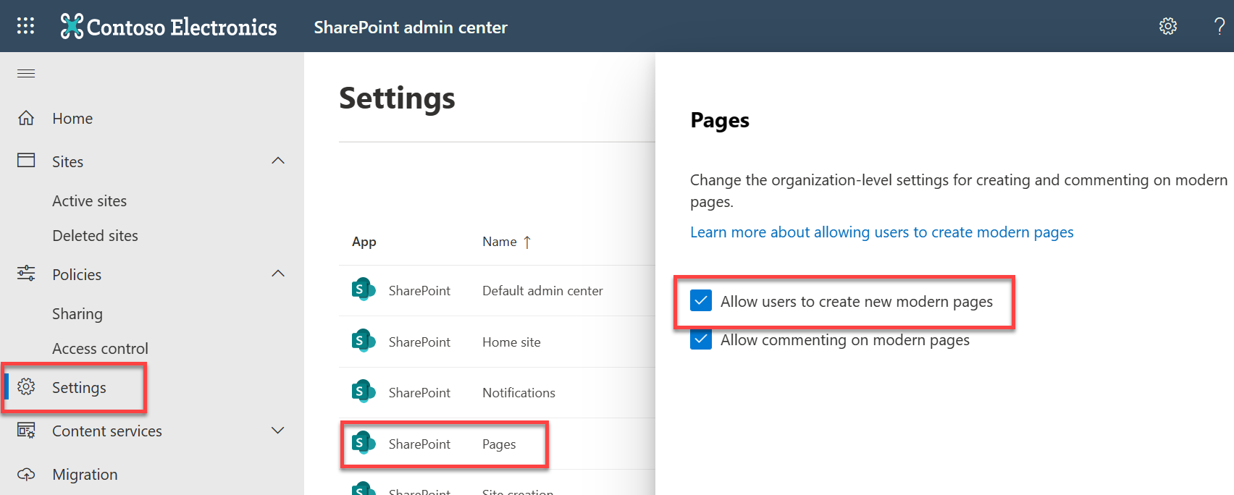
Enable Modern Site Pages
SharePoint Online pages are a great way to share ideas using text, images, Excel, Word and PowerPoint documents, video, and more.
Users can add a page to a site quickly and easily, and they look great on any device.
As a global or SharePoint admin in Microsoft 365, you can allow or prevent the creation of SharePoint Online site pages by users
Either at tenant Level (Using SharePoint Admin Center)
Or at specific Site Level (Using Microsoft PowerShell)
Notes:
If you're a global or SharePoint admin in Microsoft 365, you can allow or prevent the creation of SharePoint Online site pages by users. You can do this organization-wide by changing settings in the SharePoint admin center, or at the site level by using a Microsoft PowerShell script.
Note
When you allow creation of site pages, the Add a page command in the Settings menu creates new site pages. If you turn off the ability to create site pages, users can still add a SharePoint page from the New menu on the Home page and add it from the classic page to a Wiki library using the same command.
If instead you want to disallow the ability for members to create or modify any kind of SharePoint page, you can change the permissions on the Site Pages library to disallow editing for users in the Members group of the site.
For details on how to enable/disable Site Pages on a Site level please visit following article: https://docs.microsoft.com/en-us/sharepoint/let-users-create-modern-site-pages#prevent-users-from-creating-modern-pages-on-a-specific-site-by-using-powershell

Slide 8
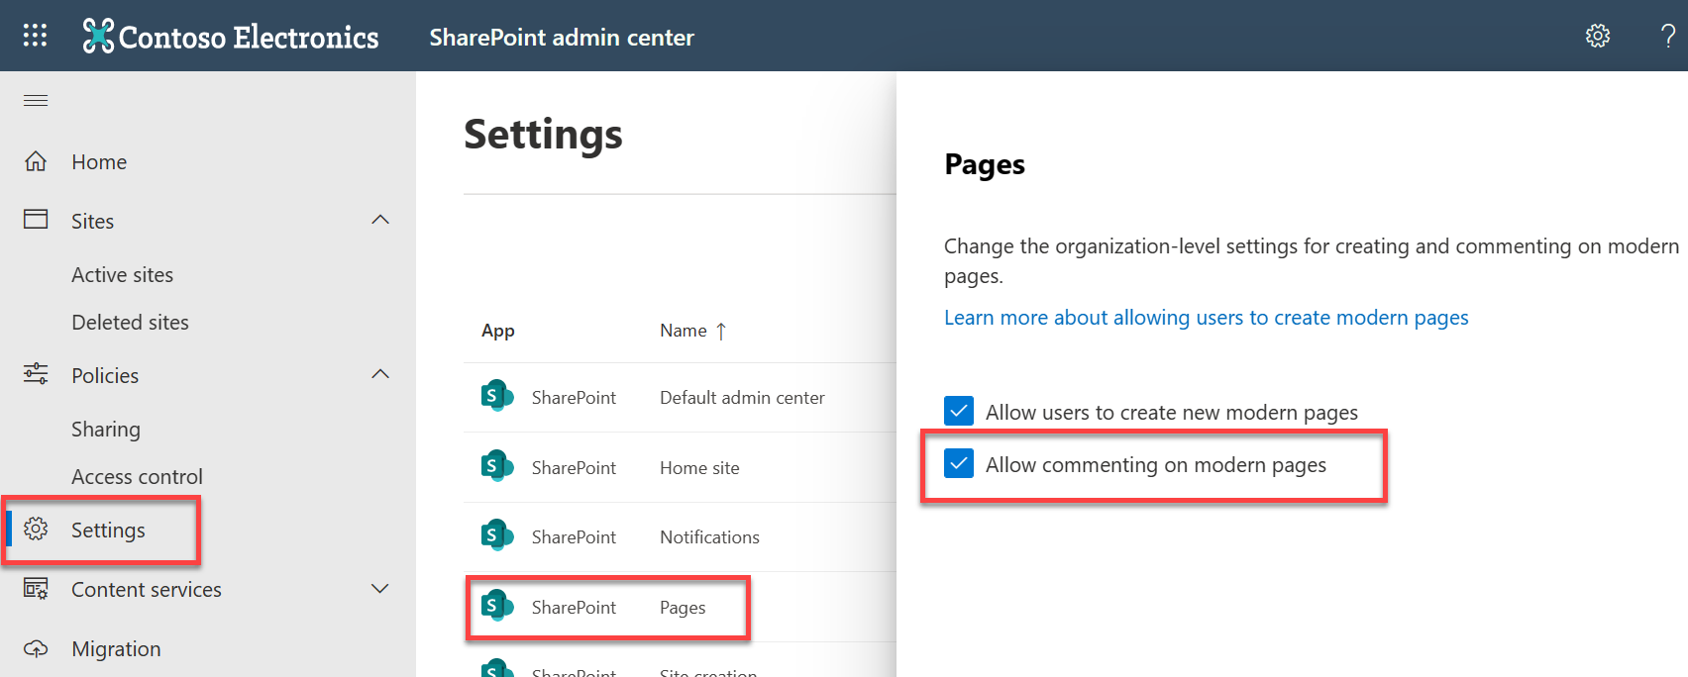
Enable Comments on Site Pages (Globally)
As a SharePoint Online Administrator, you can enable/disable possibilities for Comments on Site Pages.
Once disabled globally, comments cannot be re-enabled by Site Owners or Site Members.
Disabling comments globally does not remove the comments history and if enabled again, the whole Comments thread will be back
Notes:
One of the Site Customization decision is to enable or disable Comments on SharePoint Online Site Pages. As an administrator it is you who must configure this setting. You will find this option under “settings” section of Classic SharePoint Admin Center.
Note:
Global setting option usually takes 10-20 minutes to take effect on all sites/pages in your tenant.
Once disabled globally, comments cannot be enabled back by Site Owners or Site Members
Disabling comments globally does not remove the comments history and if enabled again, the whole Comments thread will be back!

Slide 9
Security considerations of allowing custom script
Allowing users to customize sites and pages in SharePoint by inserting script can give them the flexibility to address different needs in your organization.
However, when you allow users to run custom script
You can no longer enforce governance or scope the capabilities of inserted code
You cannot block specific parts of code or block all custom code that has been deployed
Scripts have access to everything the user has access to
Scripts can access content across several Microsoft 365 services and even beyond with Microsoft Graph integration
You cannot Audit the insertion of scipts
You cannot block inserted script
Instead of allowing custom script, we recommend using the SharePoint Framework

Slide 10
Allow custom script on other SharePoint site collections
As a SharePoint Administrator you can allow custom scripts on other (non classic and non-personal) sites as well, such as Modern SharePoint Sites.
NOTE: User custom actions and custom JavaScript are not supported on Modern sites.
You need to use Microsoft PowerShell to allow custom scripts on a site collection.
Download the latest SharePoint Online Management Shell.
Connect to SharePoint Online as a global admin or SharePoint admin in Microsoft 365.
Run the following Command
Set-SPOsite <SiteURL> -DenyAddAndCustomizePages 0
Notes:
To allow custom script on other SharePoint site collections
1. To allow custom script on a site collection, follow these steps:
Download the latest SharePoint Online Management Shell.
2. Connect to SharePoint Online as a global admin or SharePoint admin in Microsoft 365.
3. Run the following command.
Set-SPOsite <SiteURL> -DenyAddAndCustomizePages 0

Slide 11
SharePoint Online Modern Site theming - An overview for Administrators

Slide 12
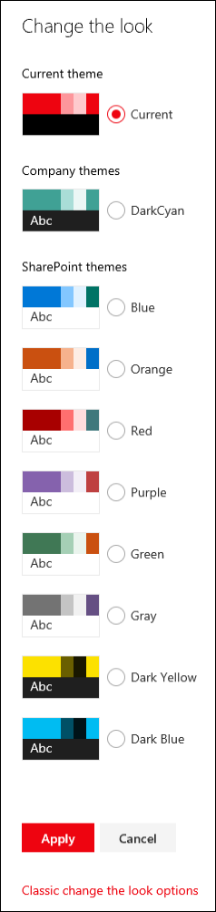
Modern SharePoint Theming
SharePoint site owners have new options for applying custom styles and colors to sites
It makes it easier to define and manage themes across site collections.
These new options include
The ability to define custom themes and make them available to site owners.
An online Theme Generator tool that you can use to define new custom themes.
A simplified set of default themes.
Control over which themes are available for use on pages within your sites.
For example, you can define custom themes based on your organization's branding or identity and make those the only available themes within your sites.
For a SharePoint/Tenant Administrator these capabilities are available via Microsoft PowerShell.
Notes:
SharePoint site owners have new options for applying custom styles and colors to sites that make it easier to define and manage themes across site collections.
These new features include:
The ability to define custom themes and make them available to site owners.
Themes are defined in a JSON schema that stores color settings and related metadata for each theme.
An online Theme Generator tool that you can use to define new custom themes.
A simplified set of default themes, with six light themes and two dark themes available.
An updated color palette, with 12 light colors and 6 dark colors, as well as 16 supplementary themes.
Control over which themes are available for use on pages within your sites. For example, you can define custom themes based on your organization's branding or identity and make those the only available themes within your sites.

Slide 13
Managing Modern SharePoint Theming
SharePoint tenant administrators can use PowerShell cmdlets to create, retrieve, and remove site themes.
The following cmdlets are available for managing site themes from PowerShell
Add-SPOTheme
Creates a new custom theme or overwrites an existing theme to modify its settings.
Get-SPOTheme
Retrieves settings for an existing theme.
Remove-SPOTheme
Removes a theme from the theme gallery.
Set-SPOHideDefaultThemes
Specifies whether the default themes should be available.
Get-SPOHideDefaultThemes
Queries the current SPOHideDefaultThemes setting.
Notes:
Site theme cmdlets
The following cmdlets are available for managing site themes from PowerShell:
Add-SPOTheme – Creates a new custom theme or overwrites an existing theme to modify its settings.
Get-SPOTheme – Retrieves settings for an existing theme.
Remove-SPOTheme – Removes a theme from the theme gallery.
Set-SPOHideDefaultThemes – Specifies whether the default themes should be available.
Get-SPOHideDefaultThemes – Queries the current SPOHideDefaultThemes setting.

Slide 14
SharePoint Site Designs and Site Script - An overview for Administrators
Notes:
IMPORTANT (AS of February 2019)
Site designs and site scripts are currently only supported by SharePoint Online.

Slide 15
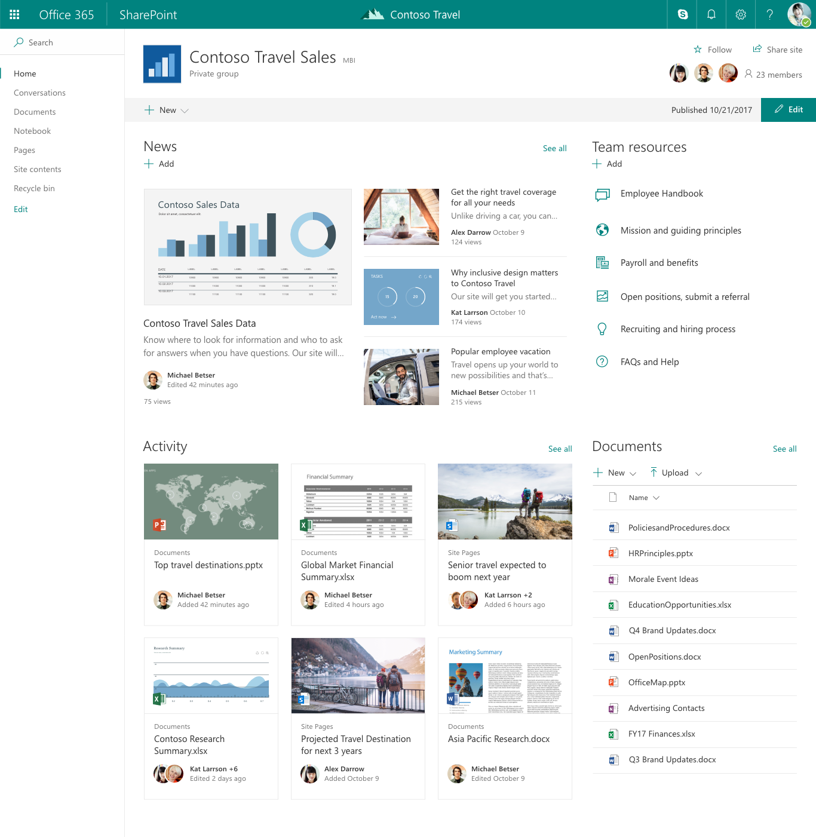
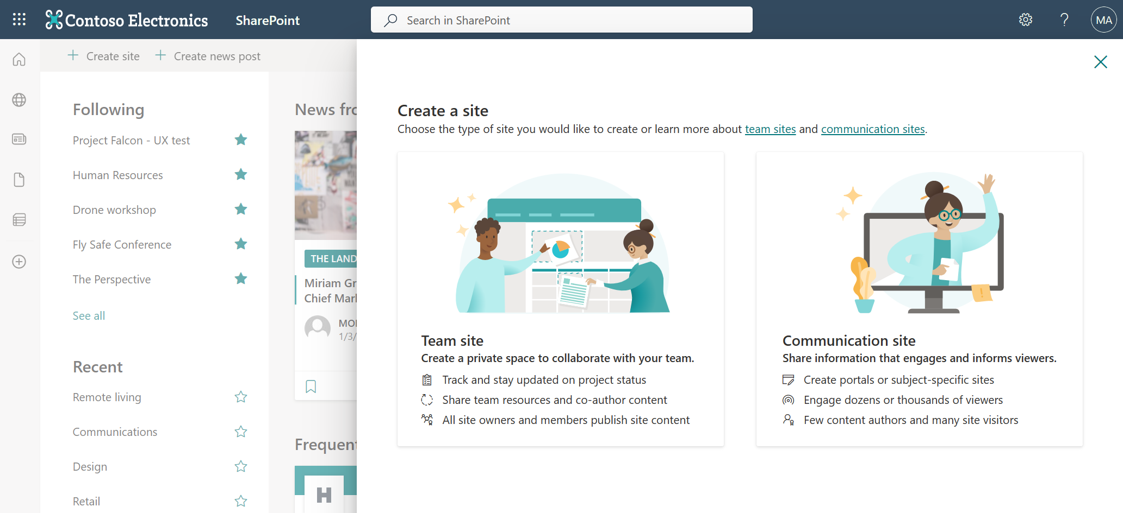
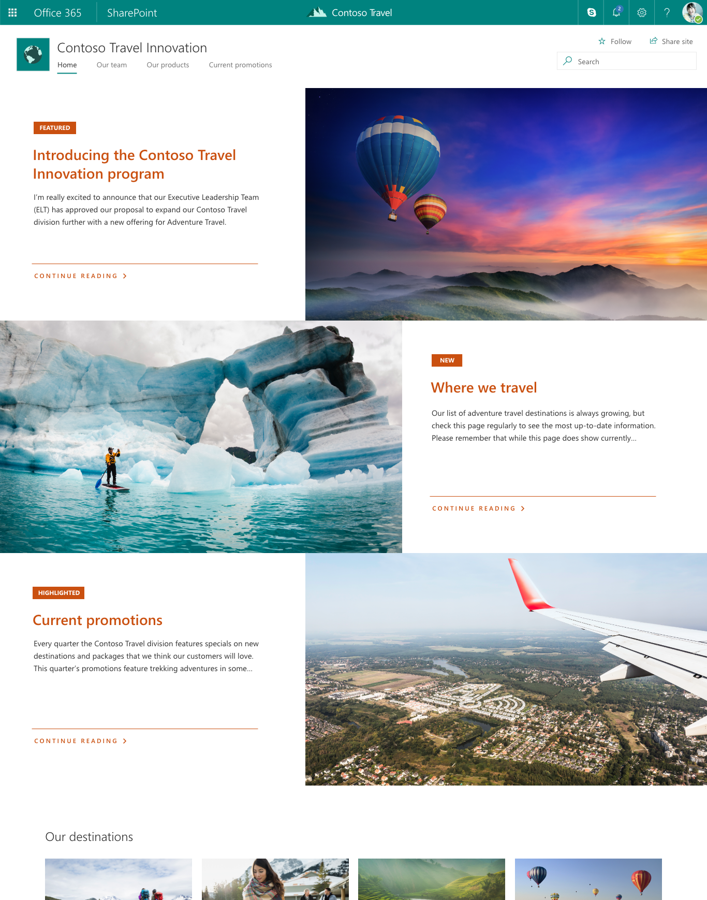
SharePoint Online Site creation: fast & modern
A new provisioning flow providing two templates
Notes:
What is modern SharePoint?
Modern SharePoint is a whole new user experience. It's more than a fresh look, it's designed from the ground up to work on mobile devices, and it addresses dozens of nagging usability issues.
The new Site Creation infrastructure is fast and provides two templates for Modern Sites
Team Site (Modern Group Connected Team Site)
Communication Site
Both types are building blocks for Modern Intranets

Slide 16
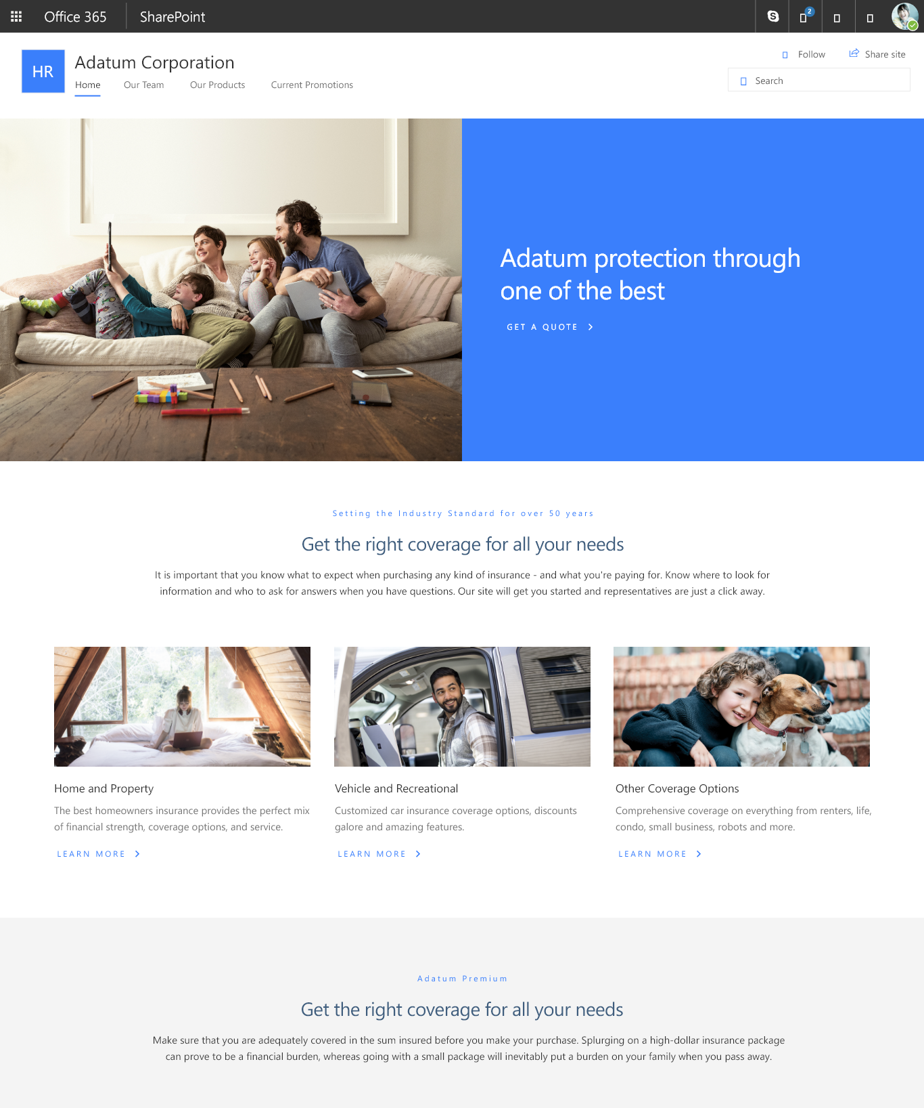
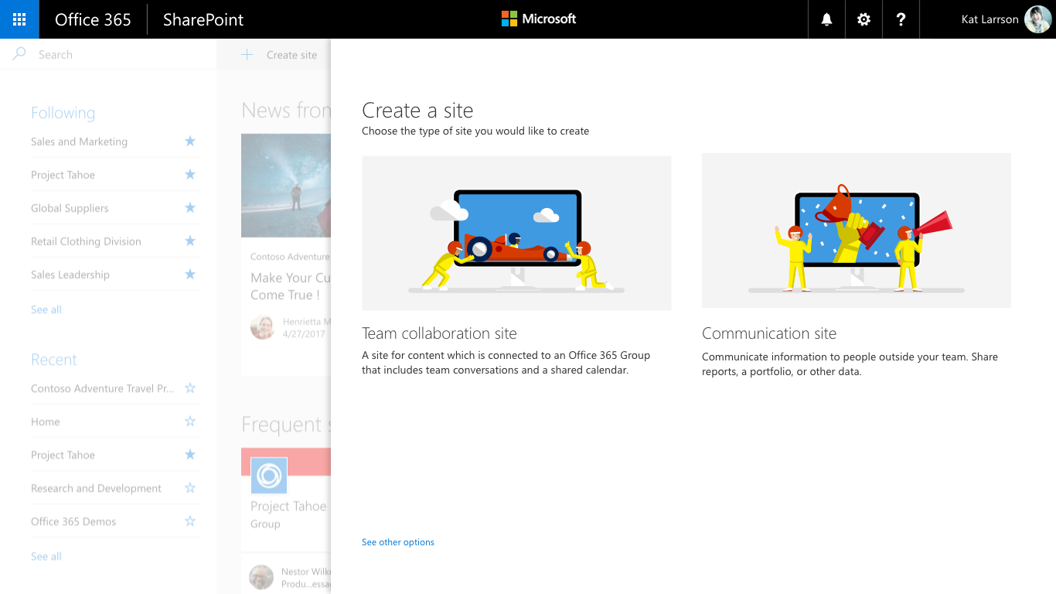
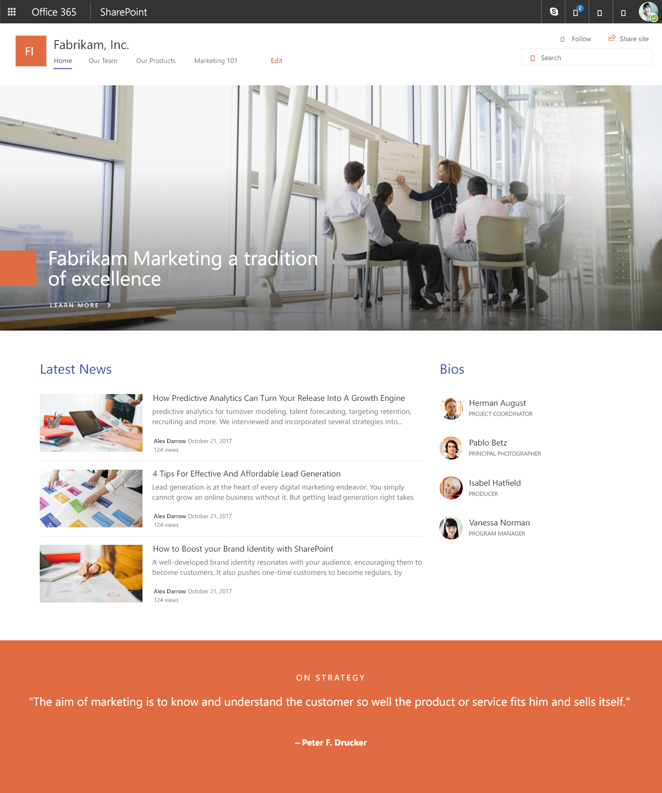
SharePoint Online Site creation: fast & modern and extensible
New capabilities to inject custom site configurations and business processes into the provisioning pipeline (Site Designs).
Notes:
Use site designs and site scripts to automate provisioning new or existing modern SharePoint sites that use your own custom configurations.

Slide 17
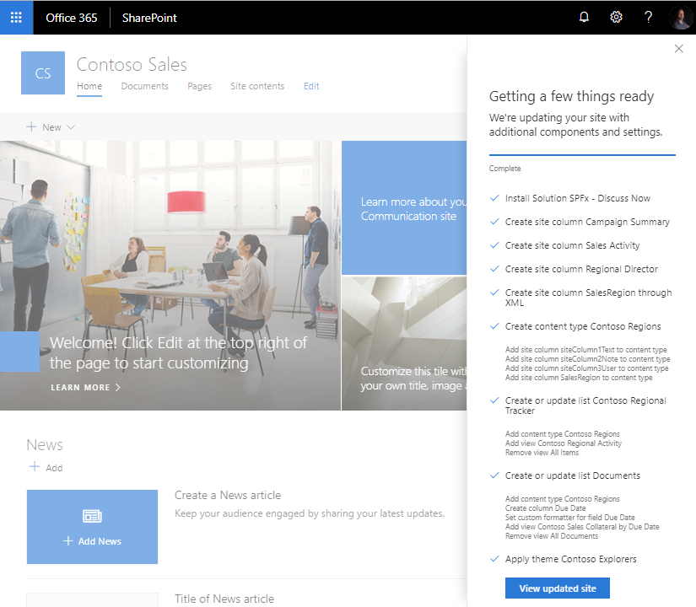
SharePoint Site Designs
A new approach for extending modern templates post-creation to automate the custom configuration of sites.
A new script model to apply custom “actions” to a site after creation.
Can be injected into the self-service site provisioning flow or manually applied to existing sites as well as at the time of joining a hub!
Site Designs ensure some level of consistency. For example, you may need proper branding and theming applied to each new site.
Notes:
When people in your organization create new SharePoint sites, you often need to ensure some level of consistency. For example, you may need proper branding and theming applied to each new site. You may also have detailed site provisioning scripts, such as using the PnP provisioning engine, that need to be applied each time a new site is created.
This article describes how you can use site designs and site scripts to provide custom configurations to apply when new sites are
Site Designs
A new approach for extending modern templates post-creation to automate the custom configuration of sites.
A new script model to apply custom “actions” to a site after creation.
Can be injected into the self-service site provisioning flow or manually applied to existing sites as well as at the time of
joining a hub!

Slide 18

SharePoint Site Designs
Site designs are like a template.
They can be used each time a new site is created to apply a consistent set of actions.
Most actions typically affect the site itself, such as setting the theme or creating lists. But a site design can also include other actions, such as recording the new site URL to a log.
They can also be applied to existing modern sites (group-connected Teams and Communication sites) by Site Administrators or Site Owners.
Site Designs use Site Scripts to apply actions to the Site.
Notes:
Site scripts are JSON files that specify an ordered list of actions to run when creating the new site.

Slide 19
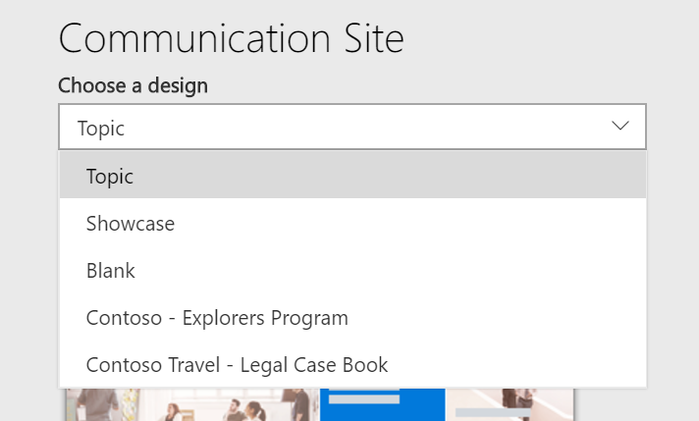
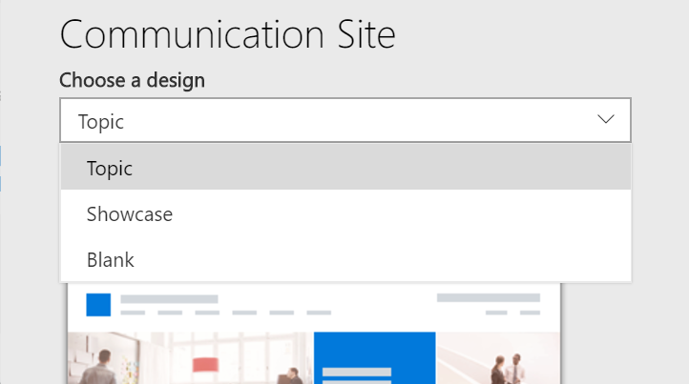
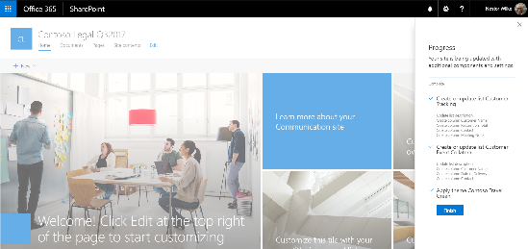
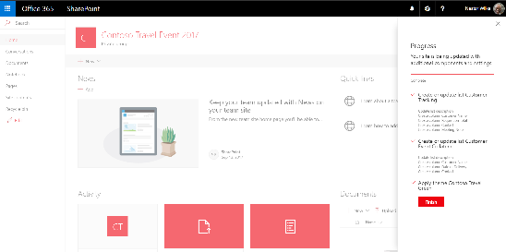
How SharePoint Site Designs work?
Site design selections appear in site provisioning UX (per base template)
1
3
Site Scripts - Actions
Execute Site Design
2
Create List
Apply Theme
Add to Nav
Trigger Flow
Join a hub site
After site creation script actions are initialized and processed – as each are run, they are saved to a local list and rendered in progress panel
During site creation we create a parameter in site property bag – this is used by site design feature to apply site scripts.
Notes:
It all starts with provisioning of a Modern Site. Site design selections appear in site provisioning UX.
Once a site design is picked during the site creation time, we create a parameter in site property bag – this is used by site design feature to apply site scripts.
Then normal site creation process runs and provisions a Modern (Team or Communication) Site. After site creation script actions are initialized and processed – as each are run, they are saved to a local list and rendered in progress panel

Slide 20
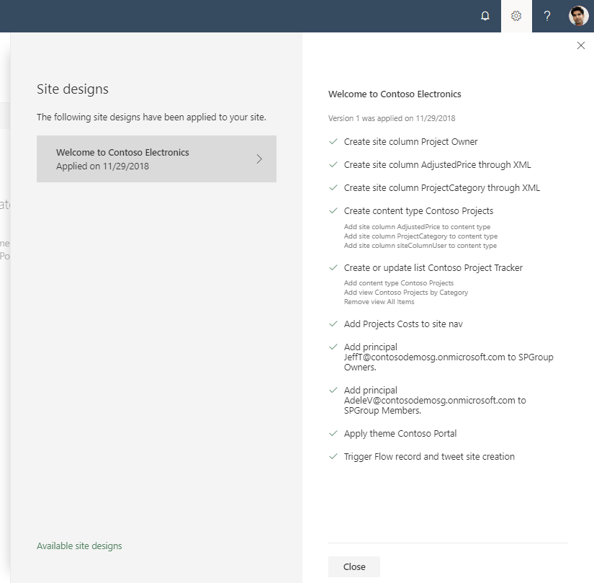
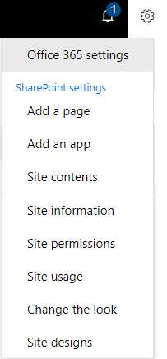
Apply Site Designs on Existing Modern Sites
Site designs can now be applied to previously created modern site collections
You can view which Site Designs have been applied to a site already and apply additional ones
Only site owners and site collection administrators have access to invoke this panel.
Notes:
We are providing a new site setting to view any applied site designs and apply additional ones - from within the sites themselves. The new site setting option is for site owners to display a new site design information panel. If any site designs have been published to the tenant, they will be displayed in the picker. Only site owners and site collection administrators have access to invoke this panel – and it respects any additional scopes on the published site designs, so only those available to the viewer will be displayed. If any sites designs have been applied to the site, they will also be displayed and can be selected to view what changes were applied.
Go to a site on your own tenant which has been created as a modern site
Click the gear icon at the top right
if you see the option “Site designs” - Click on it
If a Site design has already been applied to the site, you will see the dialog as shown on this slide at the bottom right. Using the “Available site designs” link at the bottom of this dialog you can switch to the view with all available site designs (top right screenshot).
If you do not have a site design applied to the site yet, you will start with the view of the top right screenshot. You can choose a site design from the dropdown list and apply it live on the current site.

Slide 21
Anatomy of a site script
"$schema": "schema.json",
actions: [
...
{
"verb": "createSPList",
"listName": "Contoso Project Tracker",
"templateType": 100,
"subactions":
[
{
"verb": "SetDescription",
"description": "Custom list to illustrate SharePoint site scripting capabilities"
},
{
"verb": "addContentType",
"name": "Contoso Projects"
},
{
"verb": "addSPFieldXml",
"schemaXml": "<Field Type=\"Choice\" DisplayName=\"Project Status\" Required=\"FALSE\" Format=\"Dropdown\" StaticName=\"ProjectStatus\" Name=\"ProjectStatus\"><Default>In progress</Default><CHOICES><CHOICE>In progress</CHOICE><CHOICE>In review</CHOICE><CHOICE>Has issues</CHOICE><CHOICE>Done</CHOICE></CHOICES></Field>"
},
{
"verb": "addSPView",
"name": "Contoso Projects by Status",
"viewFields":
...
Site Script: JSON file of actions to be applied to the site post-creation
Limits per tenant (as of February 2019)
100 site scripts
100 site designs
Actions can be concatenated in single file or multiple files can be used (and reused)
Site Design attributes designate display characteristics and target template
Add-SPOSiteDesign
-Title <string>
-WebTemplate <string>
-SiteScripts <SPOSiteScriptPipeBind[]>
[-Description <string>]
[-PreviewImageUrl <string>]
[-PreviewImageAltText <string>]
[-IsDefault]
Notes:
Site Designs use Site Scripts to apply actions to a Site.
What are Site Scripts?
Site scripts are JSON files that specify an ordered list of actions to run when creating the new site.
Actions can be concatenated in single file or multiple files can be used (and reused)
Site Designs uses these site scripts to modify a site.

Slide 22



Available Site Script Actions
Site Settings
SharePoint Components
Apps & Solutions
addPrincipalToSPGroup
addNavLink
applyTheme
setSiteLogo
setRegionalSettings
setSiteExternalSharingCapability
triggerFlow
joinHubSite
createSPList
addSPField
deleteSPField
addSPFieldXml
createSiteColumn
createSiteColumnXml
addSiteColumn
addContentType
createContentType
removeContentType
addSPView
removeSPView
setSPFieldCustomFormatter
installSolution
SPFx Extension support!
associateExtension
associateListViewCommandSet
associateFieldCustomizer
For a complete list of available actions and their parameters, see the JSON schema.
Notes:
For a complete list of available actions and their parameters, see the JSON schema.

Slide 23
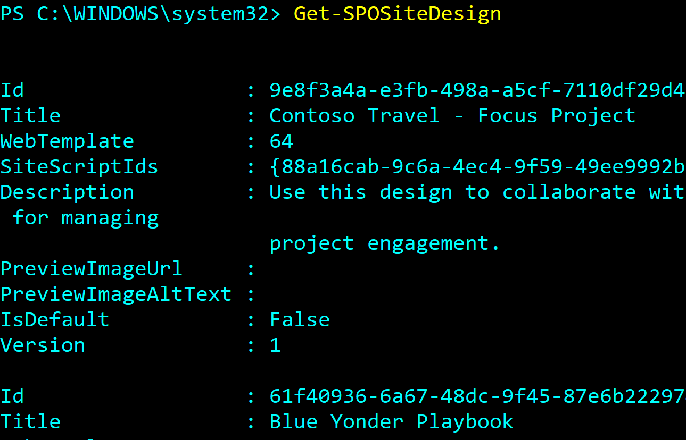
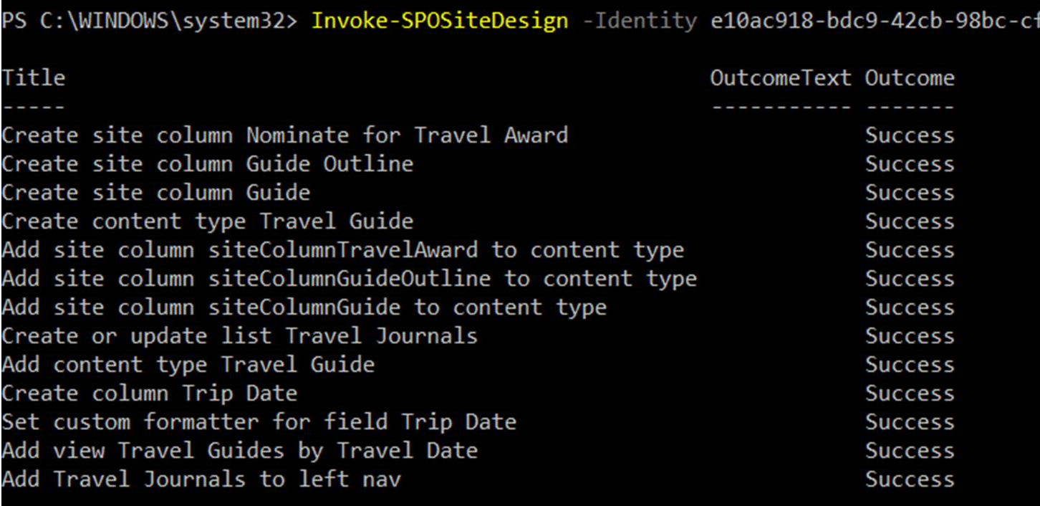
Managing SharePoint Site Designs
As a SharePoint administrator Use PowerShell or REST API to:
Create, retrieve, update, and remove site designs and site scripts.
Associate scripts to designs
Scope visibility in self-service site creation
Apply to a default template
Apply to an existing site
PowerShell: https://docs.microsoft.com/en-us/sharepoint/dev/declarative-customization/site-design-powershell
Notes:
As an administrator Use PowerShell or REST API to
Create, retrieve, update, and remove site designs and site scripts to new and existing modern site collections.
Associate scripts to designs
Scope visibility in self-service site creation
Apply to a default template
Apply to an existing site

Slide 24
Managing SharePoint Site Designs (PowerShell Cmdlets)
Add-SPOSiteDesign
Get-SPOSiteDesign
Remove-SPOSiteDesign
Invoke-SPOSiteDesign
Creates a new site design available to users when they create a new site from the SharePoint home page
Gets details about site designs that are on the SharePoint tenant. You can specify an ID of a specific site design to retrieve. If there are no parameters listed, details about all site designs are listed.
Removes a site design. It no longer appears in the UI for creating a new site.
Applies a published site design to a specified site collection target. This allows a site design to be applied to an existing site collection.
Get-SPOSiteDesignRun
Retrieves a list of site designs applied to a specified site collection
Notes:
Invoke-SPOSiteDesign - The supported site templates you can apply a site design to include: “modern” team site (with O365 group), “modern” team site (without an O365 group); communication site; classic team site; and classic publishing site
Grant-SPOSiteDesignRights - Used to apply permissions to a set of users or a security group, effectively scoping the visibility of the site design in the UX. They start off public, but after you set permissions, only those groups or users with permissions can access the site design.

Slide 25
Knowledge Check
As an administrator, why it is important to know about Modern SharePoint Themes?
Because only Global/SharePoint admins can configure themes for the Tenant using PowerShell.
What site templates are available to end users out-of-the-box in SharePoint Online?
Two, Modern Team Site and Communication Site.
SharePoint Site design is a way to inject custom site configurations and business processes into the provisioning pipeline? (True/False)
True.
Site Design can be applied to existing modern sites (group-connected Team and Communication sites)? (Yes, No)
Yes.
All actions of a Site Design are performed in JSON files. What are those called?
Site Scripts are used with Site Design.

Slide 26
Summary
In this lesson, you learned about:
Supported Customization options are available for SharePoint Online.
Concepts of site design and site scripts from and Administrator Perspective.
Modern Theming for your SharePoint Online Tenant.

Slide 27
Lab
Administrating SharePoint Online customizations

